Slide 1



Virtual sommelier
CS526-Spring 2020 Group-6
Mentor : James Abello Sai Mounica Pothuru
Aravinda Reddy Dandu
Akash Patel

Slide 2

Data
The data set contains 130K records with 14 attributes
Data is in csv format and at rest.
Data has been selected from Kaggle open datasets

Slide 3
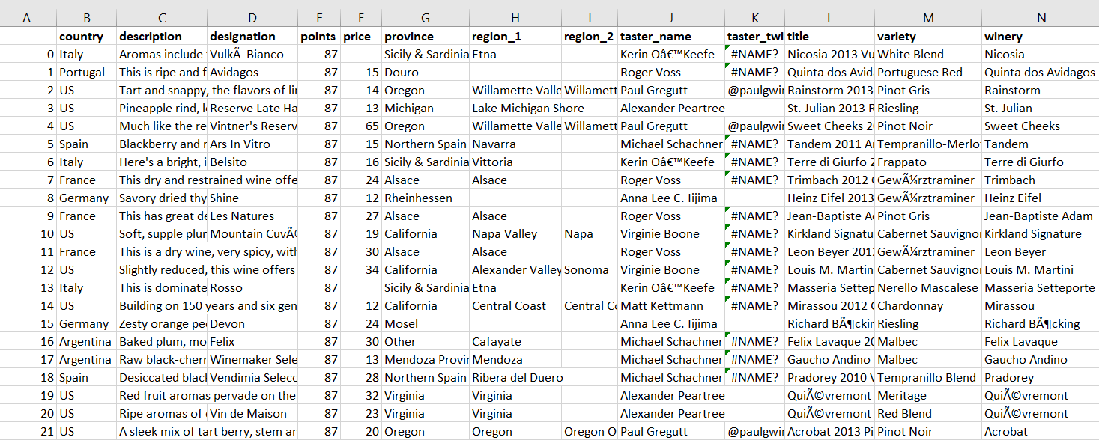
Data Snippet

Slide 4
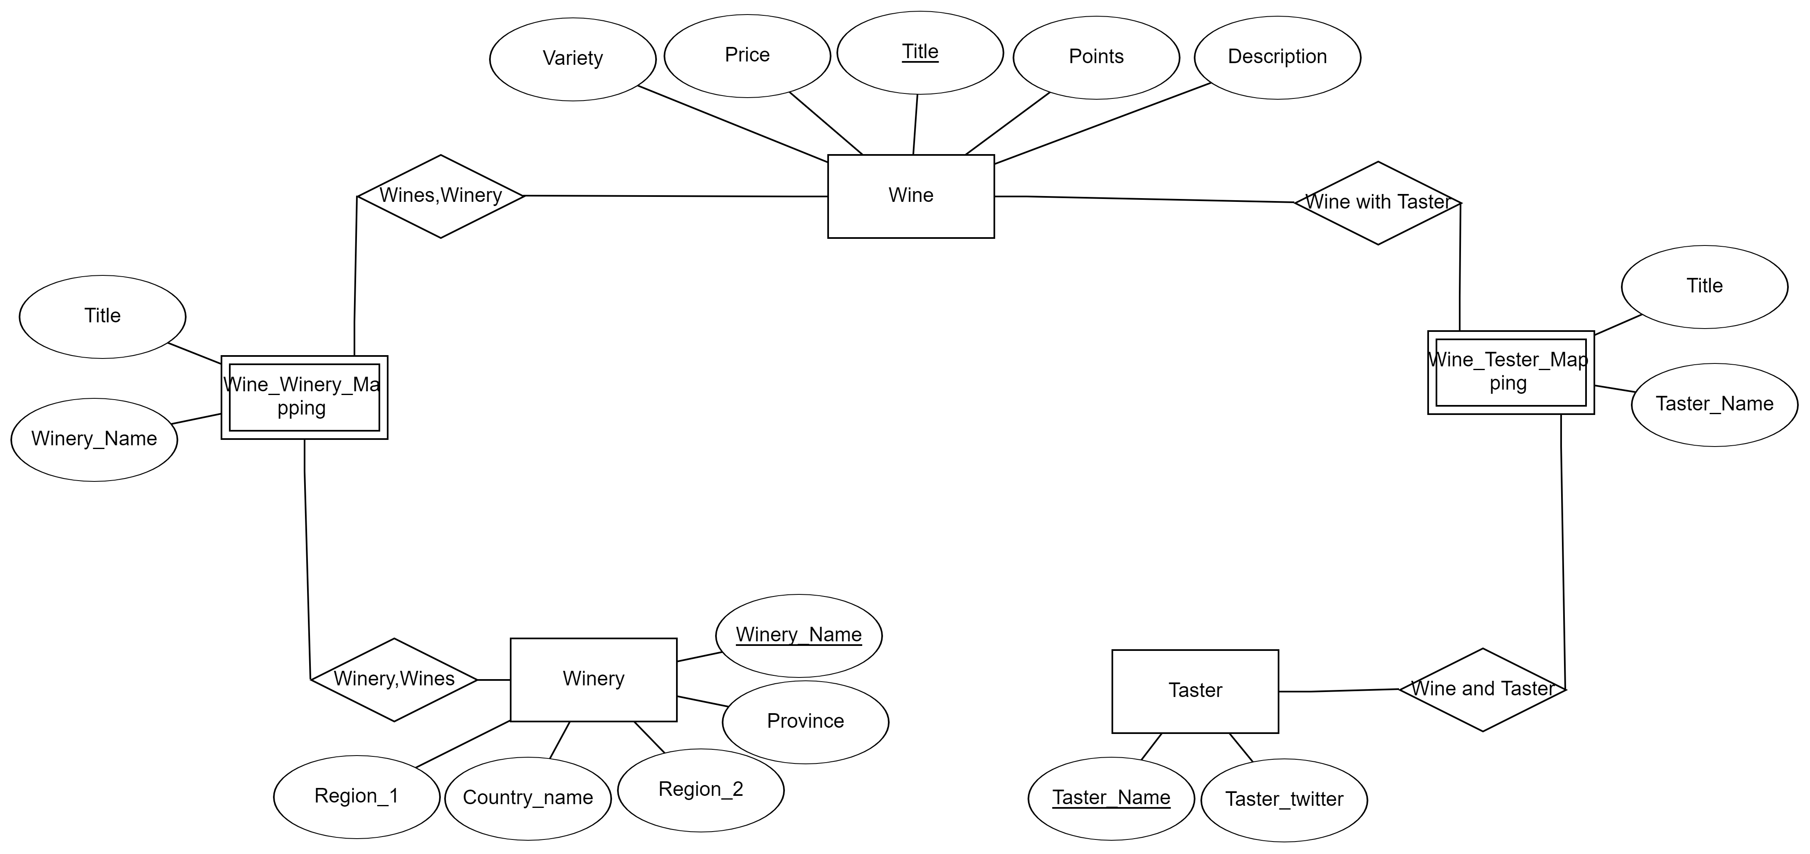
ER Diagram

Slide 5
Conceptual Flow Chart
user
Web App
request
Web Server
data
response
Csv Files
Back End Operations
Return JSON
Oracle DB
ETL
Query
Extract
TRANSFORM
LOAD
Tables
Entities, Attributes and Relationships

Slide 6
What questions can be answered
Users can get a summarized view on the available wines based on their selected continent, country and provinces.
Get a summarized description of a specific variety, the number of wines belonging to the variety and the wine level.
Users can get suggestions on wines that matches the input. Input will be taken in the form pf different attributes like country and variety and wines would be recommended.
Users have the advantage of selecting the wines based on their favorite taster’s recommendation.
Users can directly get all the information about the wines by looking at the pages.
Visual interactive representations using different plots and graphs. If the user wants visual representation of ratings of wine depending upon the country or types of wines based on country.

Slide 7

Types of Users
WINE RETAILERS
Wine enthusiast
Wine companies
restaurants
general public

Slide 8
Practical Cases
Wine Retailers
restaurants
general public
Search for different variety of wines
Analyze on optimum priced wine with better rating
Determine the estimated logistics depending on the wine and the location
Find the best suited wine varieties for their restaurant’s class
Can use this as a handbook for existing variety of wines
Choosing wines based on professional ratings and availability of variety of wines nearby.
Can get recommendations based on their palette
Determine the wines available based on their region or location

Slide 9
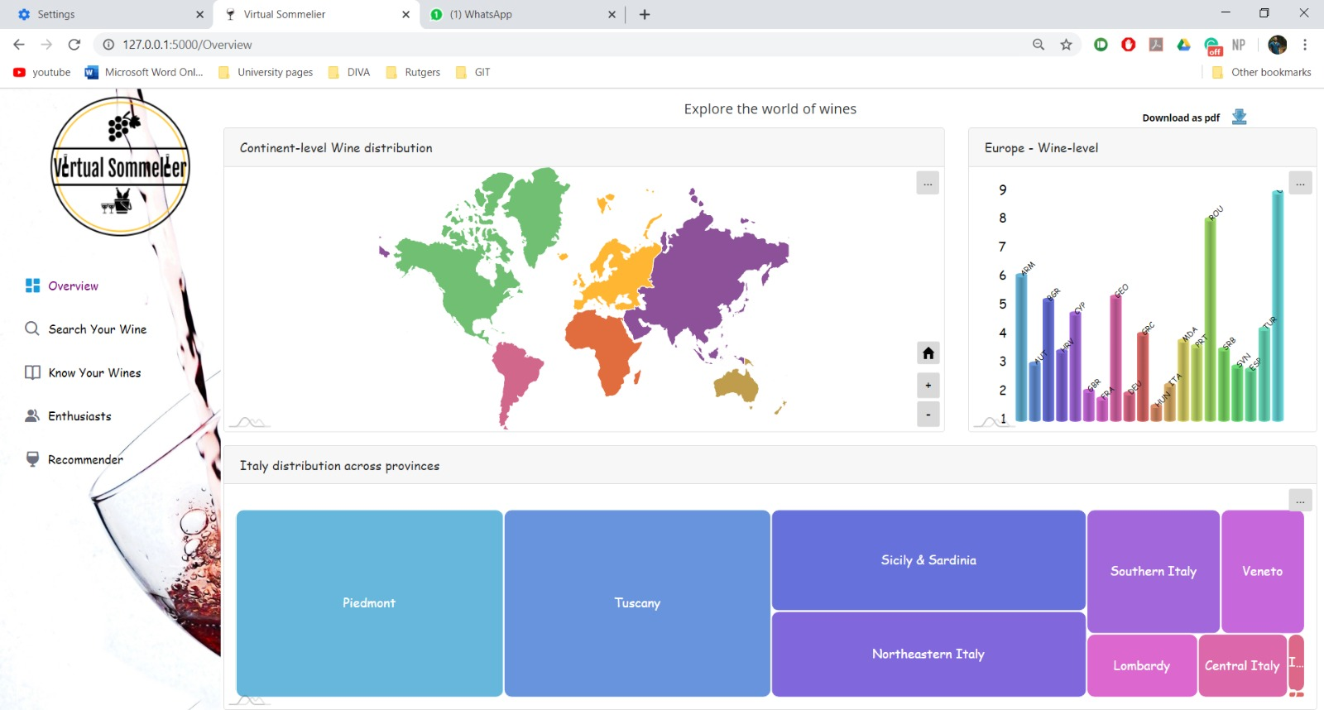
Interface Views-Overview

Slide 10
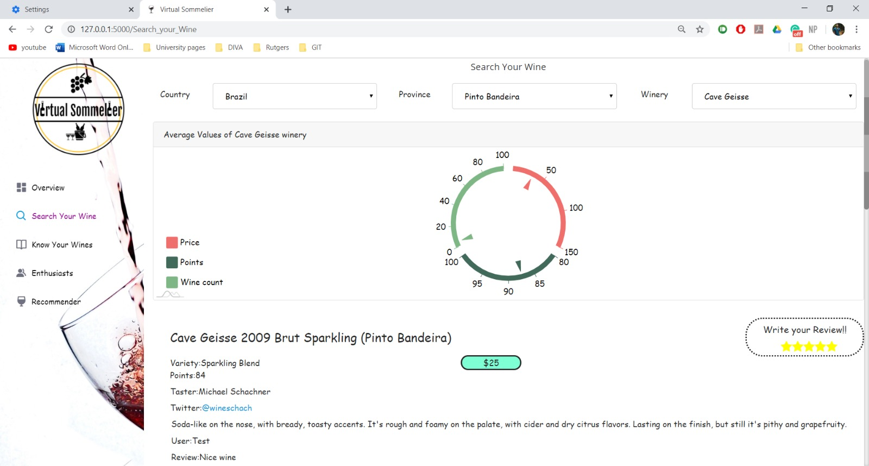
Interface View- Search your wine

Slide 11
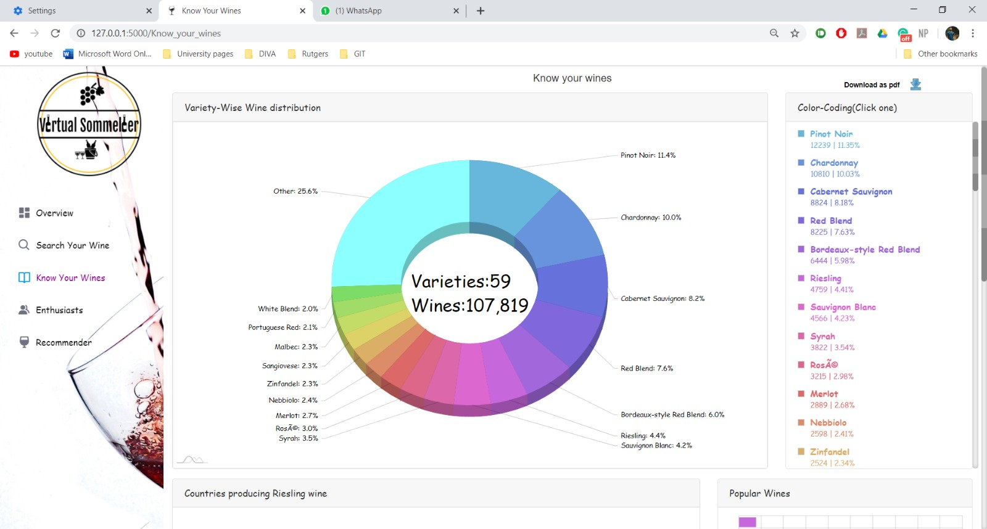
Interface View- Know your wines

Slide 12
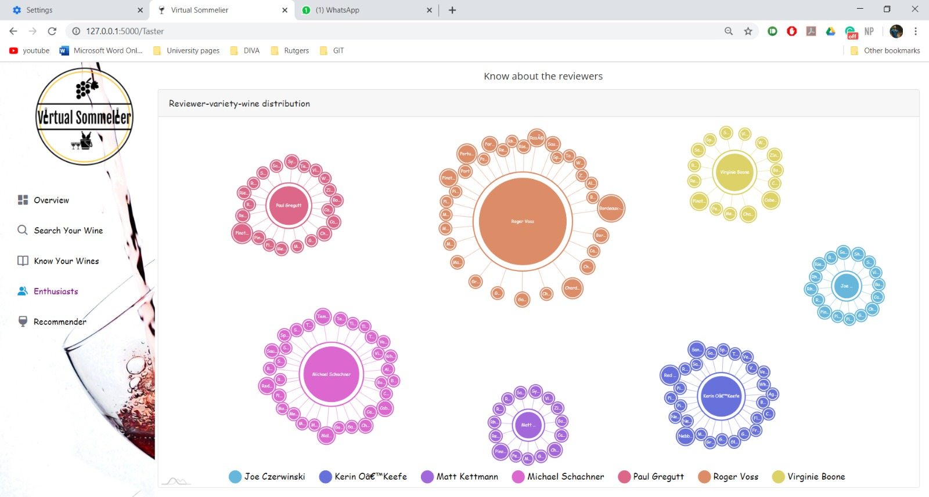
Interface View- ENTHUSIASTS

Slide 13
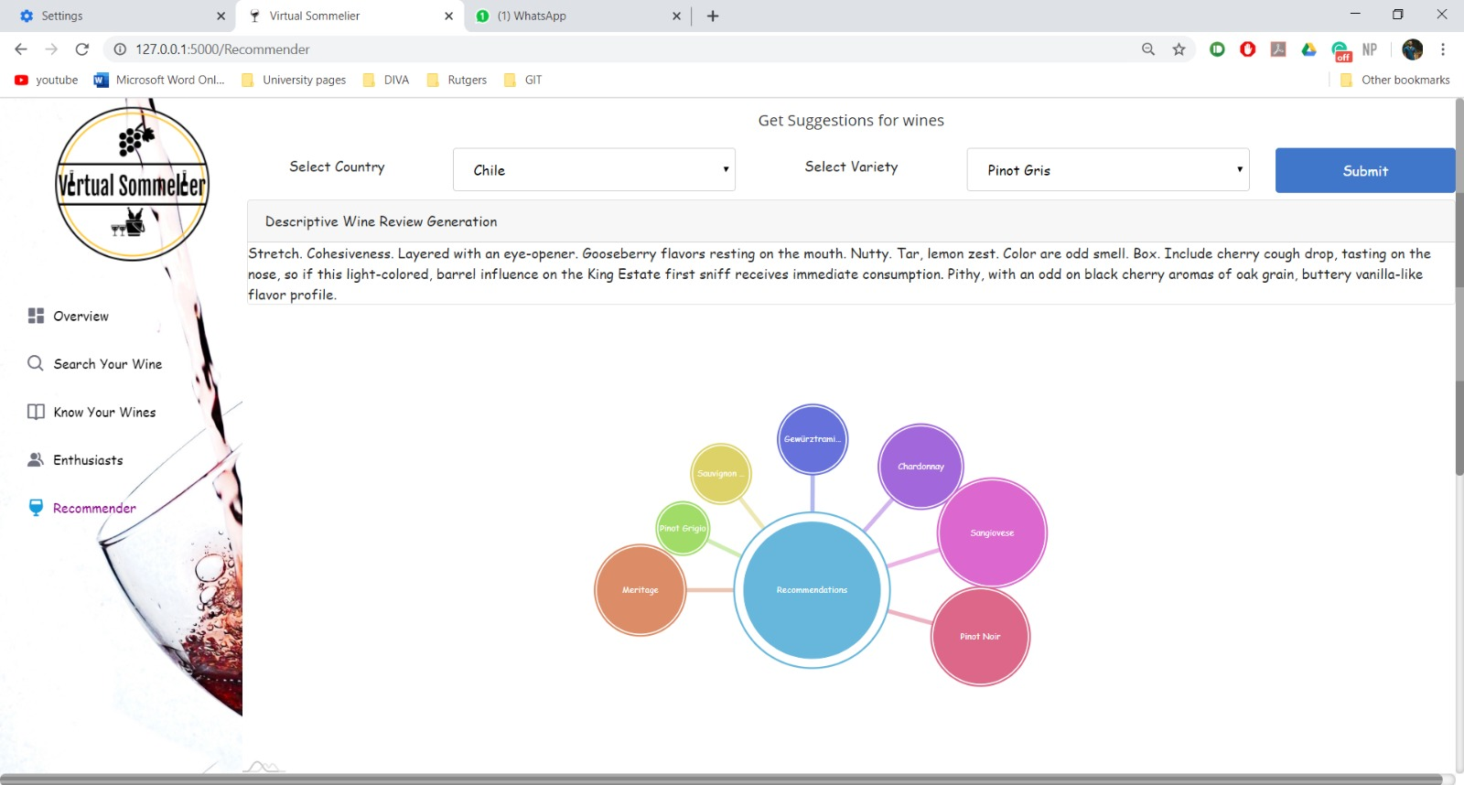
Interface View- RECOMMENDER

Slide 14
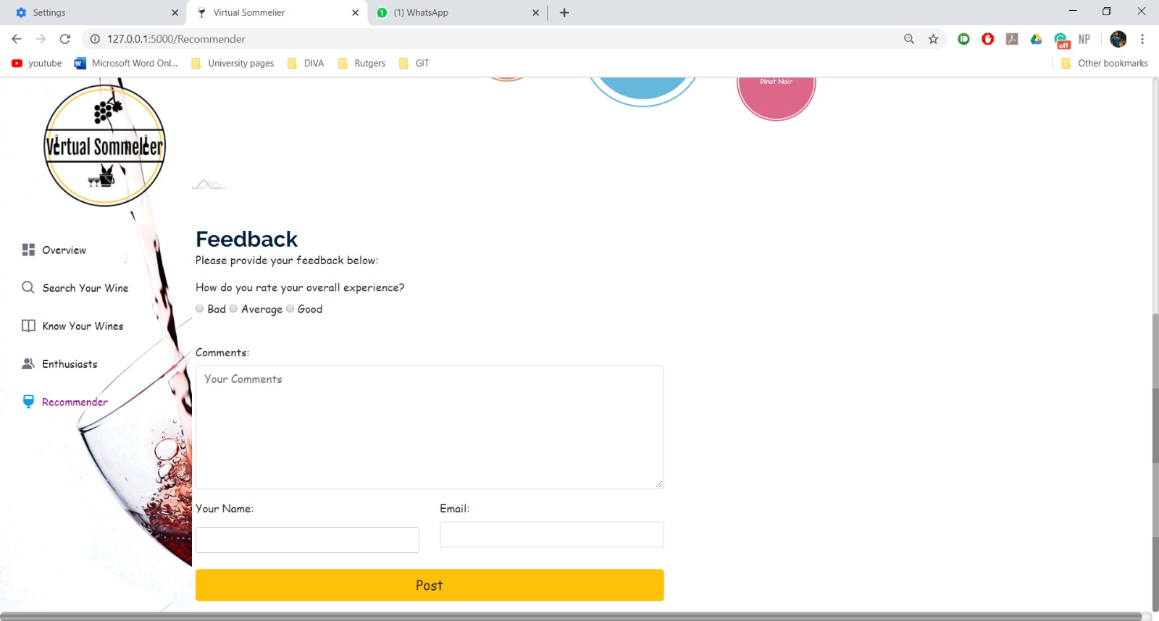
Interface View- Recommender

Slide 15
Tools
Database: ORACLE
BACK-END: Python FLASK
FORNT-END:HTML5,CSS3, bootstraP, JAVASCRIPT, JQUERY,AMCHARTS AND D3.JS

Slide 16
Interactivity
Menu driven tabs
Mouse clicks, Mouse hovering and Mouse selections will be used
Zooming – Mouse Control
Panning
Sliders
Labeling
Multi-Interactive views

Slide 17
DEMO

Slide 18
Interesting findings
There are very few varieties of wine like Pinot Noir, Chardonnay, Cabernet Sauvignon etc. which contribute a large portion of the world varieties. These three varieties contribute almost one-thirds of world varieties production.
There are few countries which produce quality wine even with cheaper rates. Ex: Ukraine, Romania, Mexico etc. (Price is low, points are high)
Although preparation method of most of the wines is same, their taste differs a lot as seen from the word cloud chart of each variety.
Most wine enthusiasts focus on a specific set of varieties they like. For example Roger Voss specializes on Bordeaux-style Red Blend(2916 reviews) as he’s from France. It can be seen 54% of Bordeaux variety is from France (Page 3- Know your wines).
People who like Riesling wine are more likely to find Pinot Noir(dist-658) suitable while people who like Chardonnay are less likely to like it (dist-195). Although both are from US, there’s disparity between two popular varieties.

Slide 19
Future Work
Using Feedbacks to improve the user experience.
Scaling up current system to handle more traffic.
Adding a functionality to that can integrate other wine datasets with the existing datasets.

Slide 20
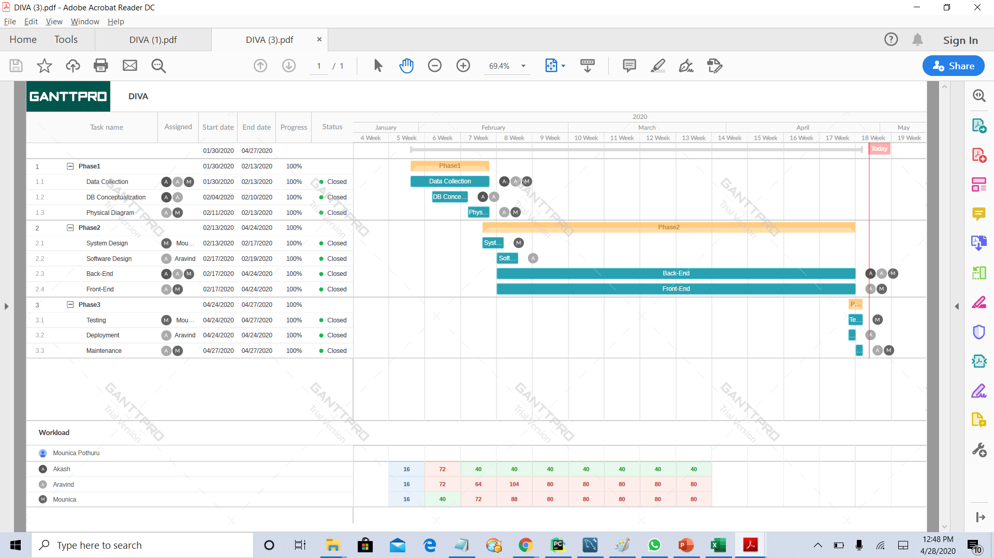
Gantt Chart

Slide 21
REFERENCES
https://www.amcharts.com/
https://getbootstrap.com/
https://www.w3schools.com/bootstrap4/default.asp
https://app.ganttpro.com/

Slide 22
Thank You! Questions?

